Slide 1


Agile Retrospectives
Notes:
Welcome to this training on retrospectives.
The timeframe for this training is approximately 2 hours after which there will be time for Q&A.
The contents of this presentation are licensed under a Creative Commons Attribution-ShareAlike 4.0 International License.
For more information about the license, visit:
http://creativecommons.org/licenses/by-sa/4.0/

Slide 2
Today’s Schedule
What?
How?
Why?
Notes:
Today we will look at the following topics:
Why do we do retrospectives.
How to do a retrospective, were we will go through the theory of retrospectives, how they are structured and will look at some examples of each phase in a retrospective.
What do we do in retrospectives. Last but not least we will go through several tips & tricks from real life retrospectives and an overview of resources to learn more about retrospectives.

Slide 3

Notes:
But first we will play a game!
[Notes for presenter]
Play a ball game:
3 balls are used in this game.
Make sure a roll of duct-tape is available.
1 person needs to keep time.
1 person needs to record the results on a flip chart.
A group of 6 to 8 people need to pass/throw the balls around. After this first round the group needs to iterate and evaluate to do it faster each iteration with the following requirements:
The order in which the 3 balls are passed needs to stay the same.
Each person needs to make contact with all the balls one by one.
Anything else is allowed.
At the end of each iteration the group evaluates and discusses improvements.

Slide 4

Notes:
Observe and discuss the results of the ball game with the entire group of training participants.

Slide 5
WHY?
Notes:
To learn how we can do retrospectives, first we need to understand why we do them.

Slide 6
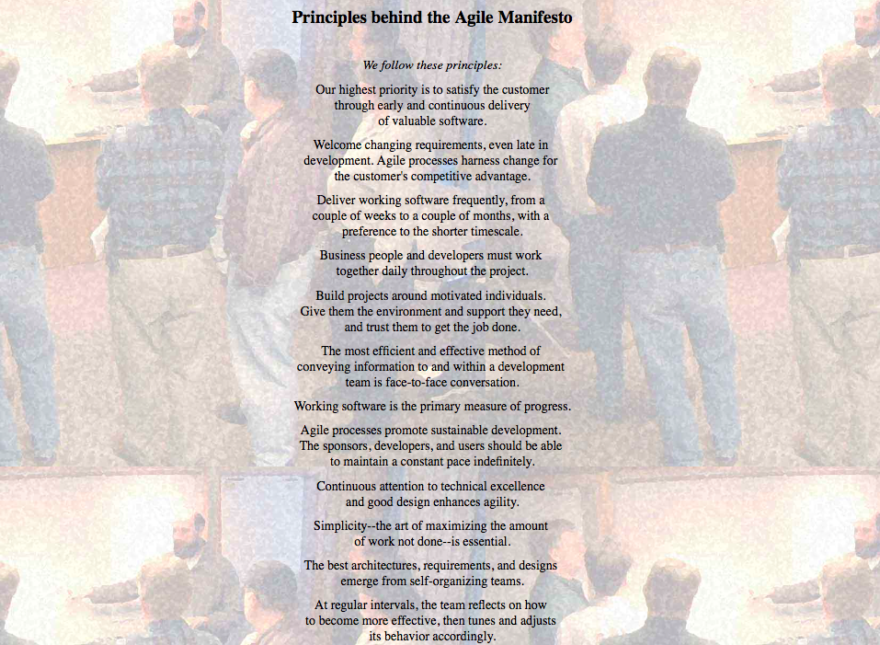
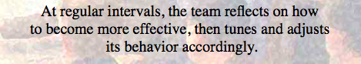
Why do we do retrospectives?
WHY?

Slide 7
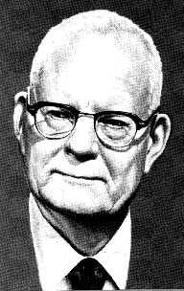
Why do we do retrospectives?
W. Edwards Deming
WHY?

Slide 8
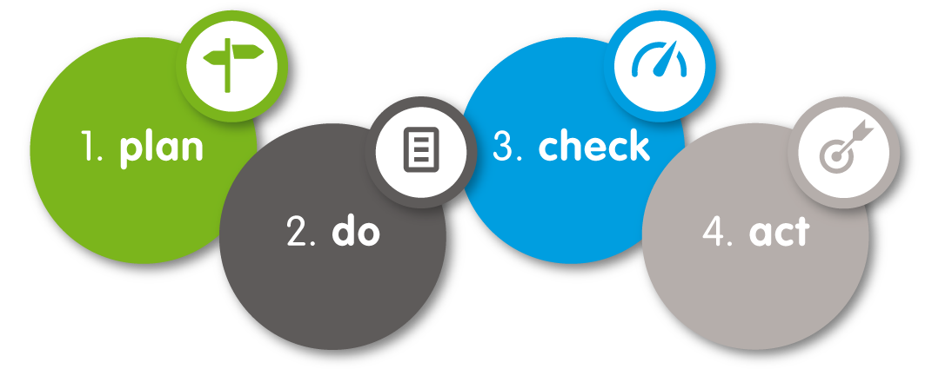
Why do we do retrospectives?
WHY?

Slide 9
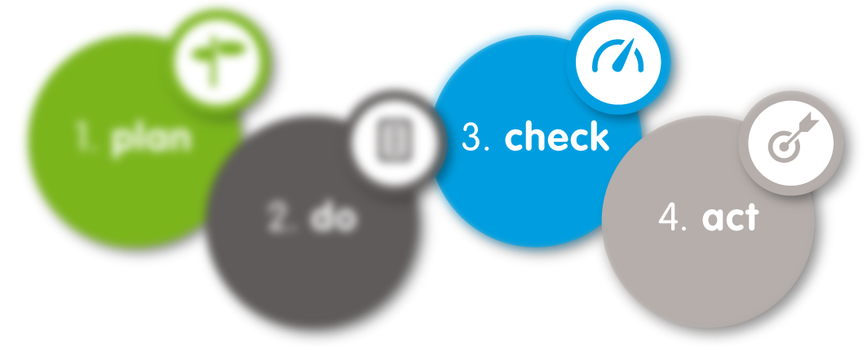
Why do we do retrospectives?
WHY?

Slide 10
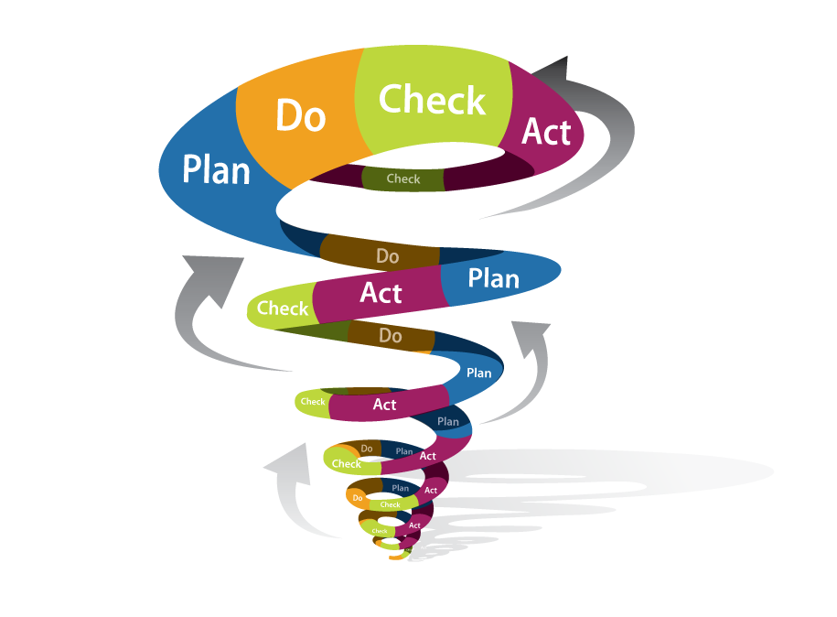

Why do we do retrospectives?
WHY?

Slide 11
Why do we do retrospectives?
What if we don’t?
WHY?

Slide 12
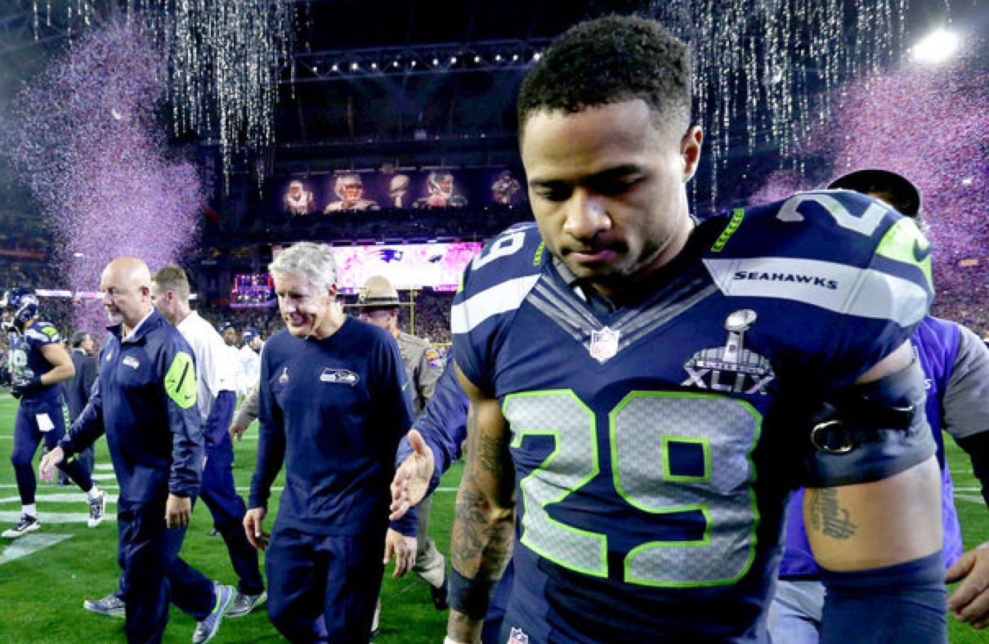

Slide 13
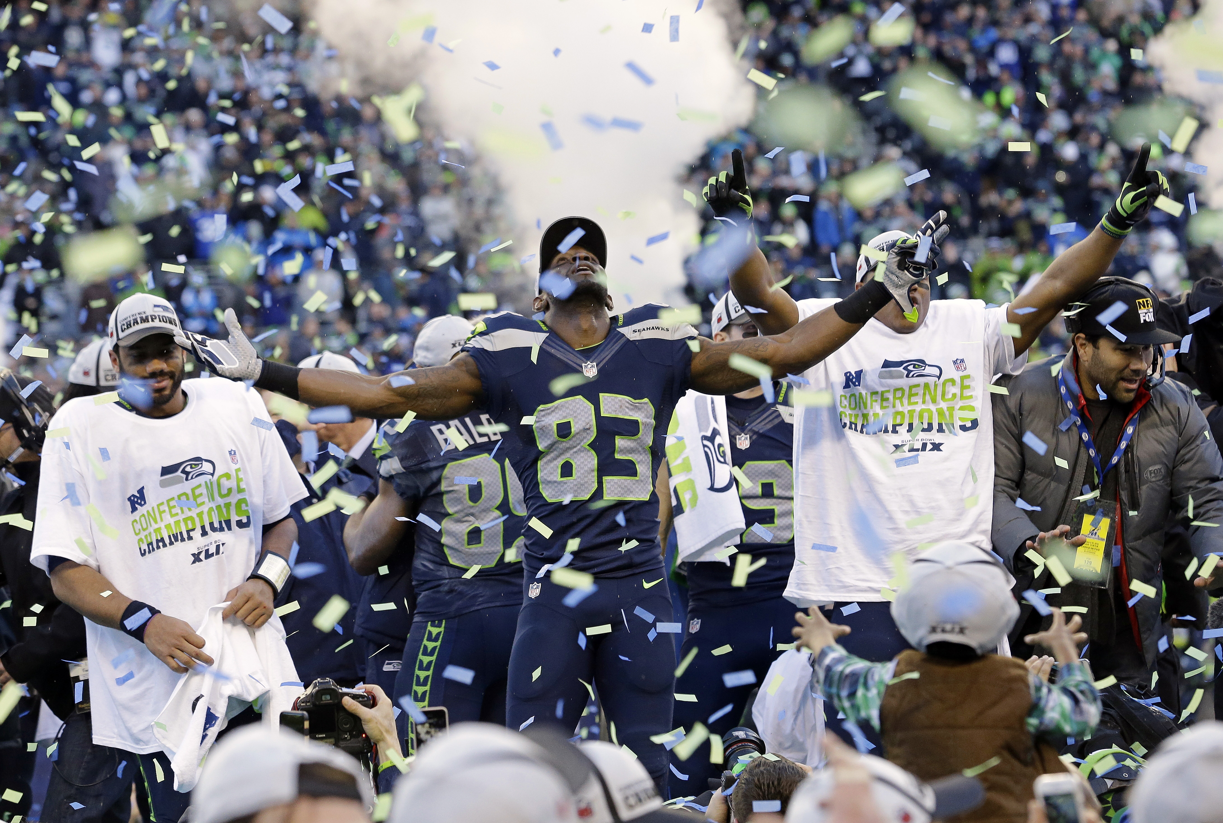

Slide 14
HOW?

Slide 15

The Scrum process
Sprint retrospective
HOW?

Slide 16
The Retrospective
Each sprint should have a retrospective.
It is the last activity in the sprint.
Allocate time for it.
Use the outcomes.
HOW?

Slide 17
Retrospective structure
Set the Stage
Gather Data
Generate Insights
Decide What To Do
Close
HOW?

Slide 18
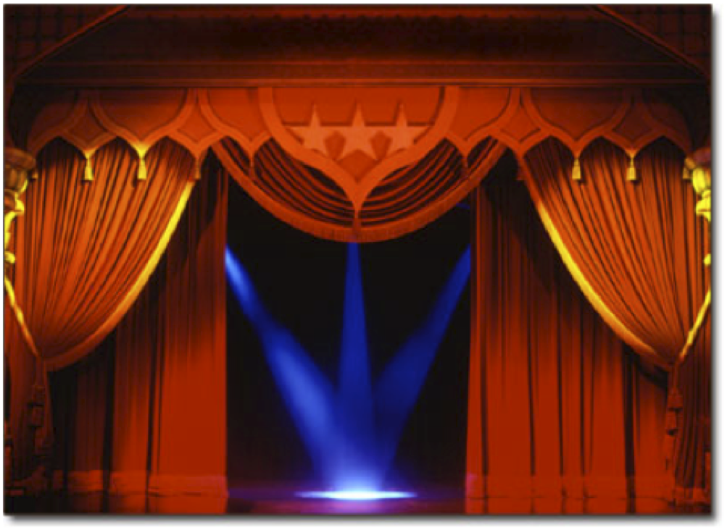
Set the stage

Slide 19
Setting the stage
Goal:
Set the context for the retrospective.
Create a comfortable atmosphere.
Get everybody engaged.
HOW?

Slide 20
Setting the stage
As a facilitator:
Welcome everyone to the retrospective.
Explain the goal, timebox and agenda.
Use a short check-in exercise to get people engaged.
HOW?

Slide 21
Setting the stage | Example 1
Check-In:
Ask one question that each person can answer with one word or short phrase.
Each participant answers or explicitly passes.
Don’t go into discussion
Examples:
Your feeling about the sprint in one word?
Your hopes for the retrospective?
What do you need from this session?
HOW?

Slide 22
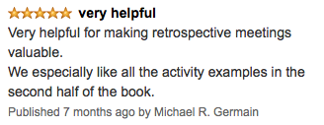
Setting the stage | Example 2
Amazon review:
Write a short Amazon style review on the sprint with:
Star rating 1 to 5
Title
Content
Let everyone read out their review.
Record the star rating on a flip chart.
HOW?

Slide 23
Setting the stage
Important:
Keep it short, but don’t skip it.
If you don’t engage them here you wont engage them later on.
HOW?

Slide 24

Gather Data

Slide 25
Gather data
HOW?

Slide 26

Generate Insights

Slide 27
Generate insights
HOW?

Slide 28

Decide what to do

Slide 29
Decide what to do
HOW?

Slide 30

Close the retrospective

Slide 31
Close the retrospective
HOW?

Slide 32
WHAT?

Slide 33

Tips & Tricks
WHAT?

Slide 34


Preparation
A retrospective takes preparation time
How much?
WHAT?

Slide 35

Preparation
Prepare to throw your plan away.
WHAT?

Slide 36
Preparation
But keep facilitating.
WHAT?

Slide 37

Preparation
Ask for help:
A colleague.
A Scrum master from another team.
An agile coach.
The agile community.
WHAT?

Slide 38
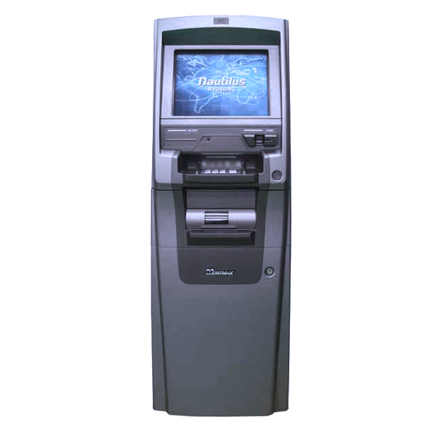
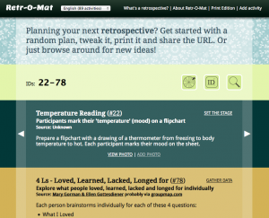
Preparation
The Retro-Mat: http://www.plans-for-retrospectives.com
WHAT?

Slide 39
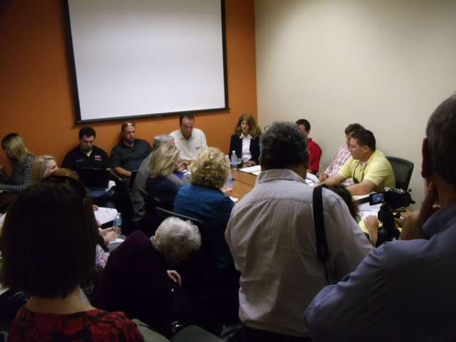
Location & Environment
WHAT?

Slide 40
Location & Environment
Pay attention to the location and environment:
Get rid of meeting room tables.
People should be able to move freely.
Light and oxygen.
Facilitation supplies galore.
WHAT?

Slide 41



Location & Environment
Snacks
Music
WHAT?

Slide 42
Location & Environment
But we don’t have suitable locations.
Be creative:
Atrium.
Canteen.
Local restaurants and bars.
Roof terrace.
WHAT?

Slide 43
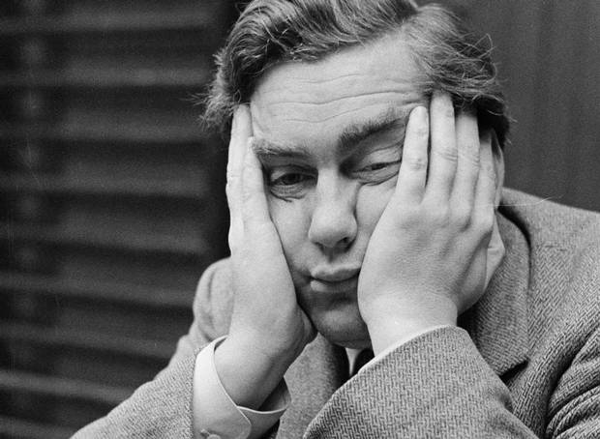
Variation
WHAT?
Notes:
Using the same format over and over again endlessly will get people bored.
Boredom in retrospectives is one of the worst things you can have. Bored people are not fully engaged in the retrospective and won’t contribute.

Slide 44
Variation
100+
retrospective formats available
WHAT?

Slide 45
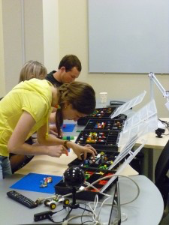
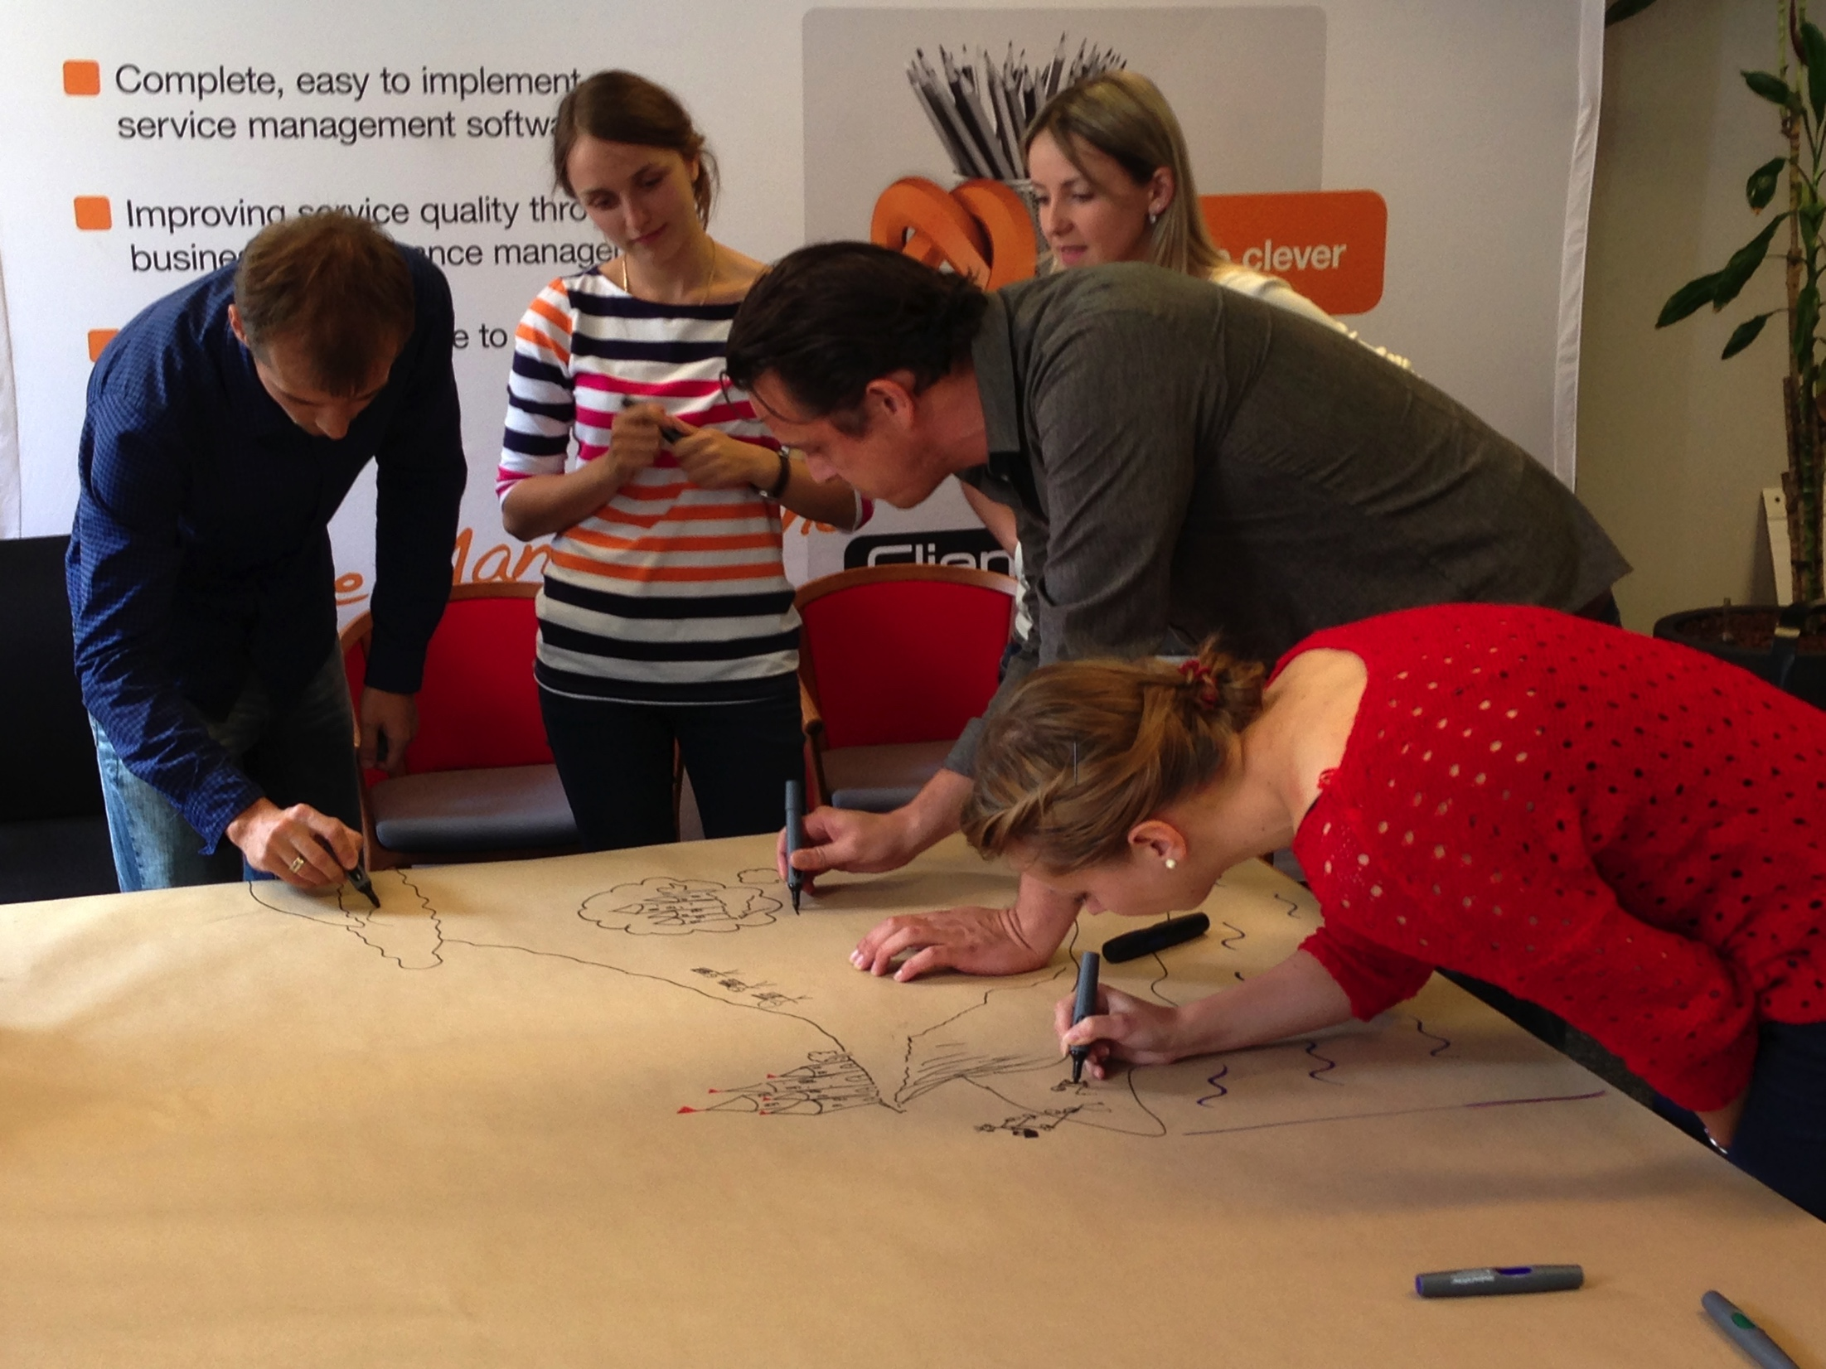

Variation
Trigger creativity.
WHAT?
Notes:
Triggering creativity will bring up discussions that would otherwise not surface.

Slide 46
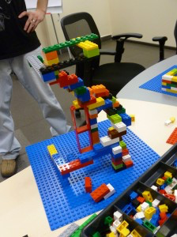
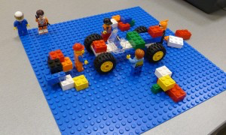
Variation
WHAT?

Slide 47
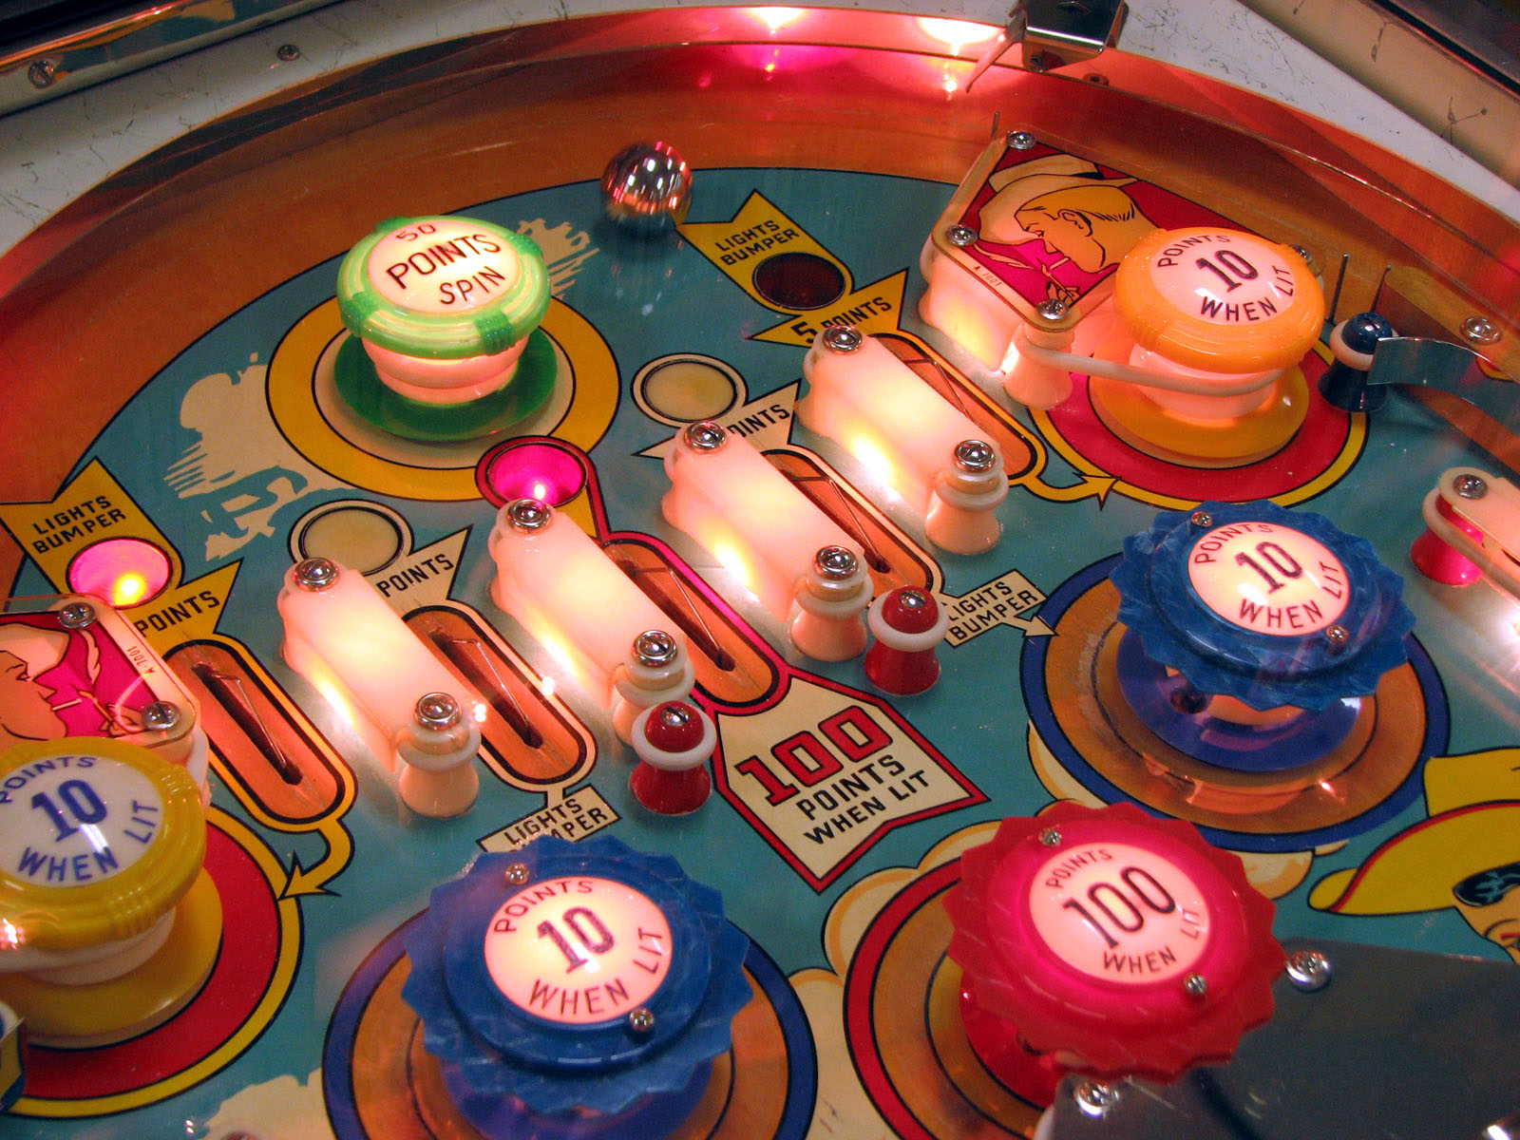
Variation
WHAT?
Notes:
You also don’t want to give people the feeling that they are in a pinball machine, bouncing in a different direction every time.
When bringing variation in your retrospectives, make sure to find a balance that accommodates the team.

Slide 48
Facilitation
Split up in small groups to get everyone’s input.
WHAT?

Slide 49
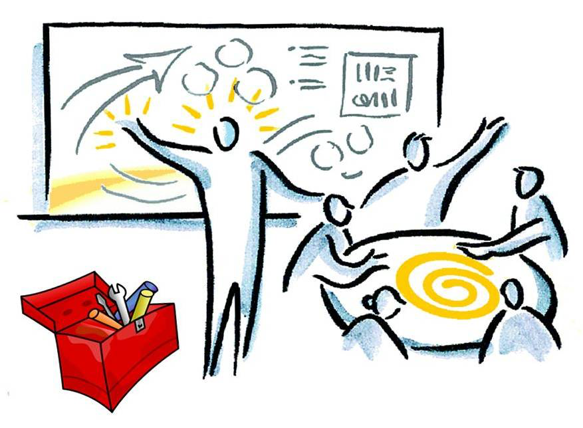
Facilitation
To facilitate or to participate, that’s the question.
WHAT?

Slide 50
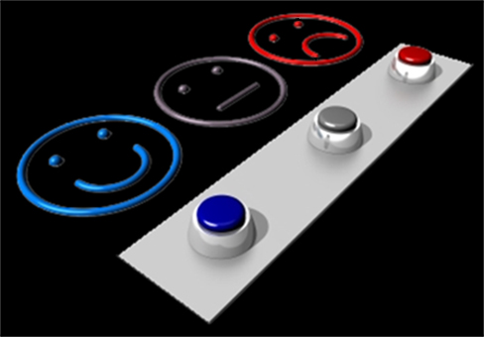
Facilitation
Evaluate yourself as a facilitator
WHAT?

Slide 51
Facilitation
Evaluate yourself as a facilitator
Example: close the retro with “helped, hindered, hypothesis”
Or use the Amazon review
WHAT?

Slide 52
Remote retrospectives
…..
WHAT?

Slide 53


Slide 54

Learning about retrospectives
A must read:
Agile retrospectives, making good teams great
Esther Derby & Diana Larsen
WHAT?
Notes:
A must read for everyone that is learning about retrospectives is the book from Esther Derby & Diana Larsen. This book will explain the basic structure of retrospectives as it is also used in this presentation and gives a large number of sample excercises for each phase of the retrospective.

Slide 55
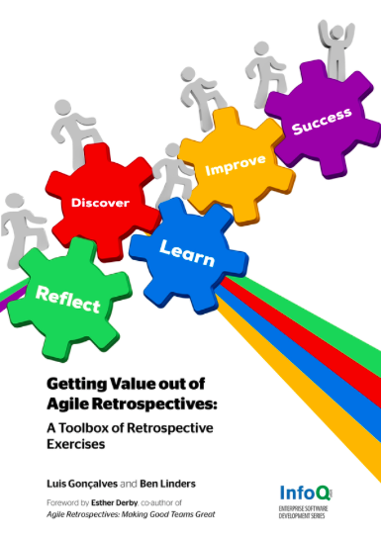
Learning about retrospectives
Retrospective exercises
Availabe for free online on LeanPub https://leanpub.com/gettingvalueoutofagileretrospectives
WHAT?

Slide 56
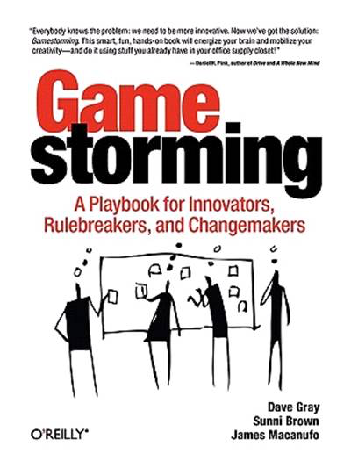

Learning about retrospectives
Useful work formats for retrospectives
WHAT?

Slide 57
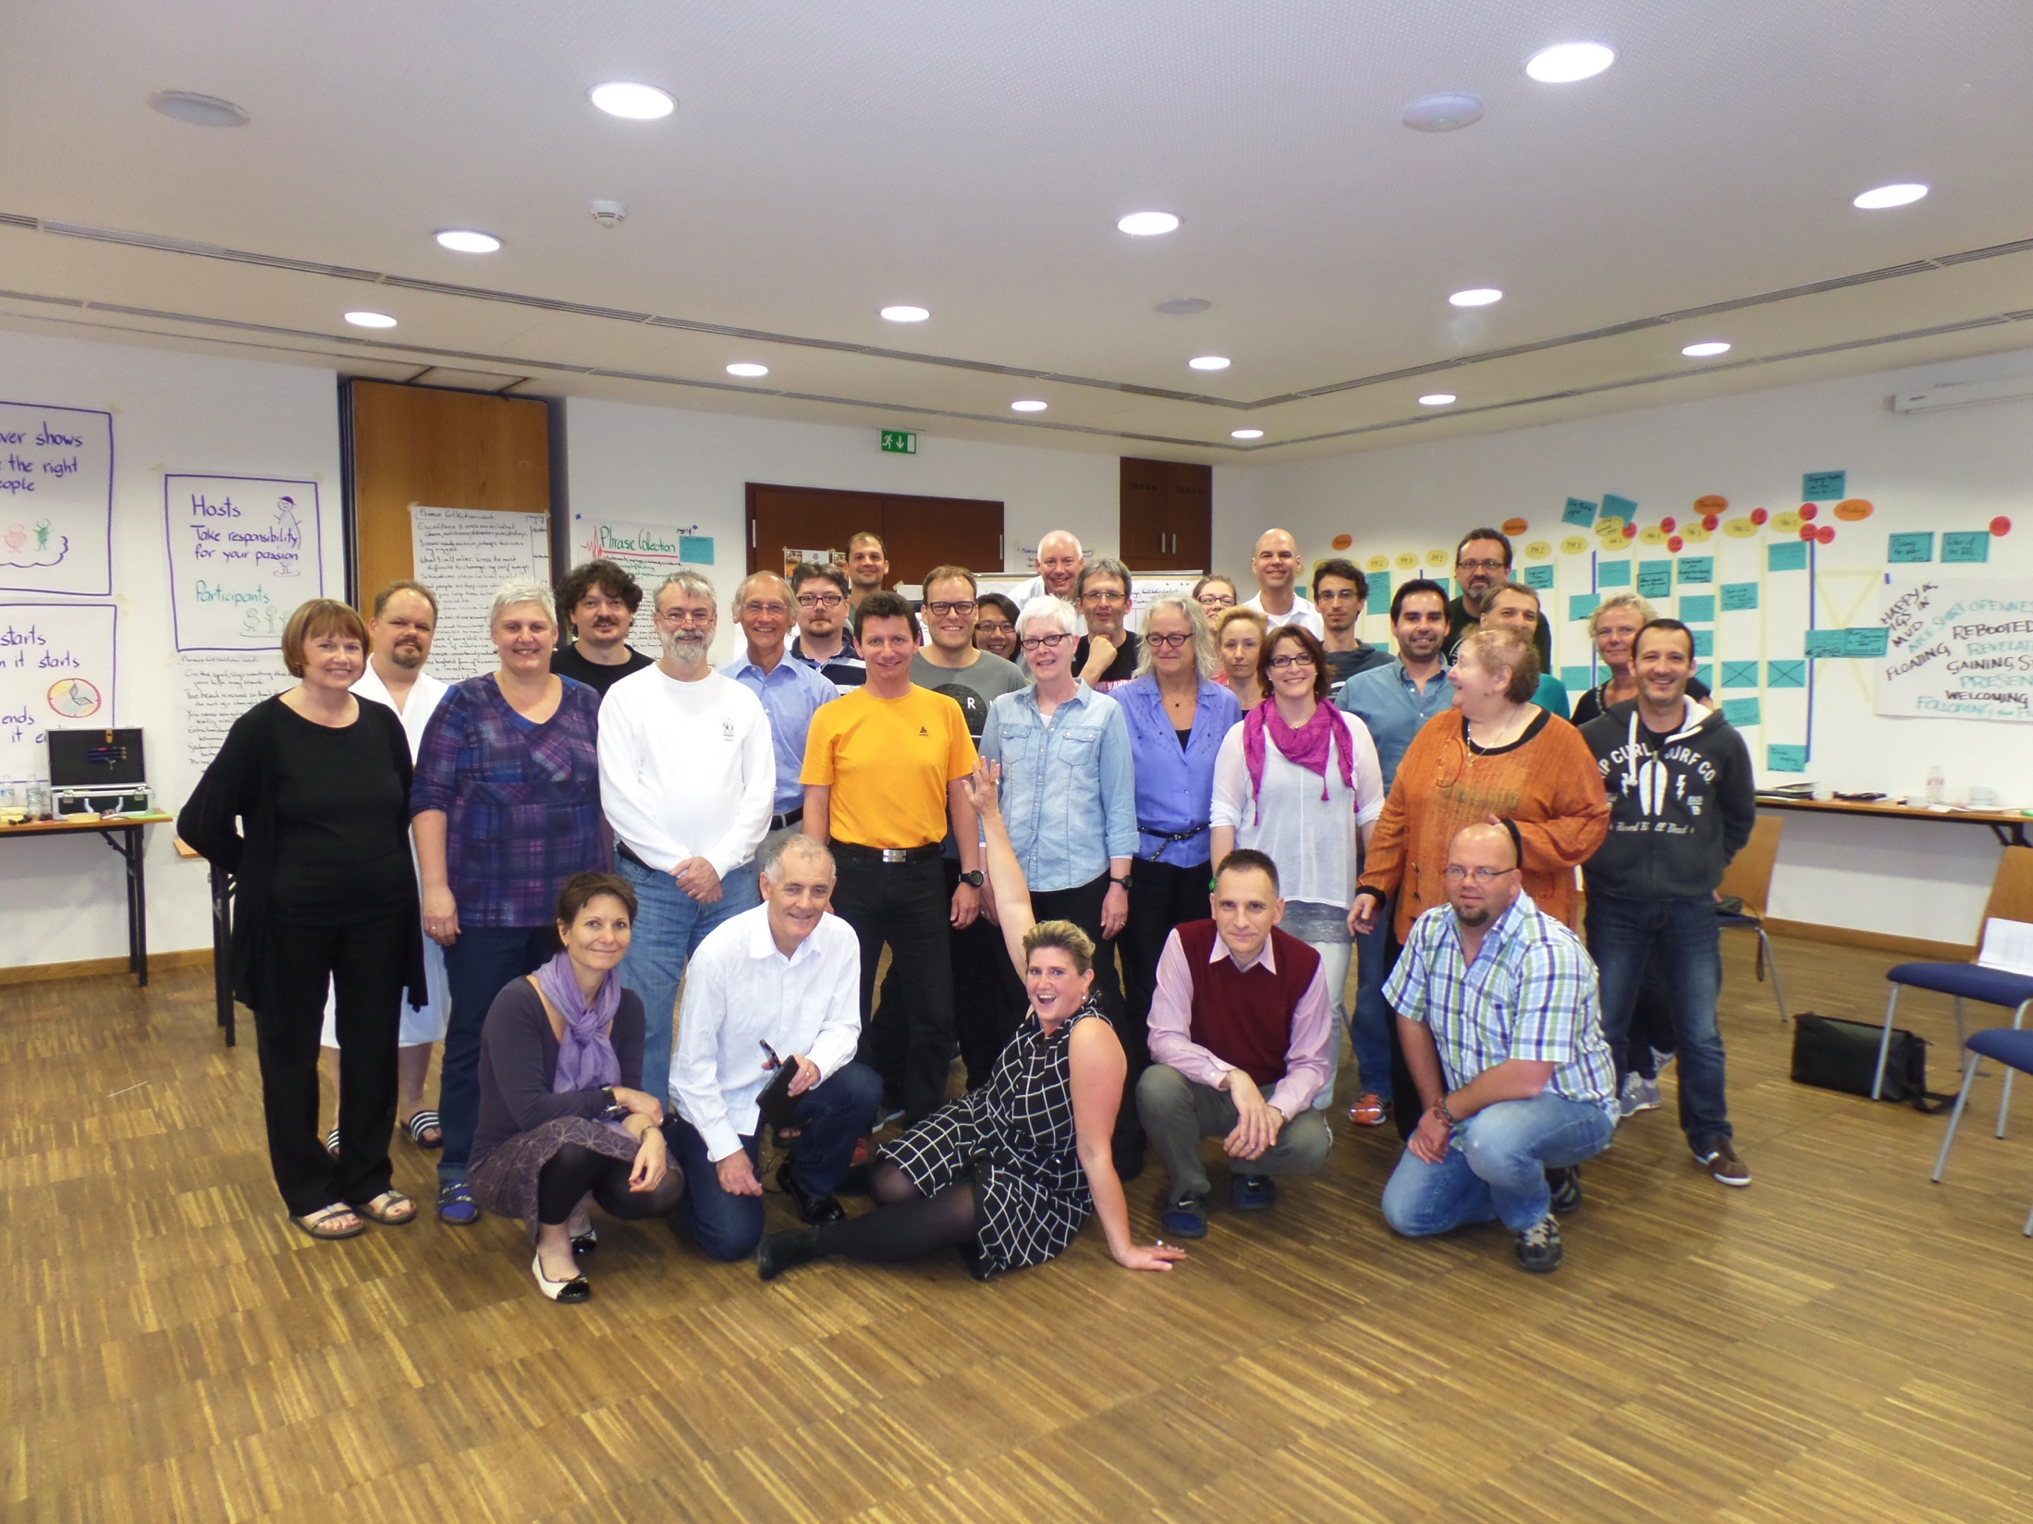
Learning about retrospectives
Retrospective
Facilitators
Gathering
WHAT?

Slide 58

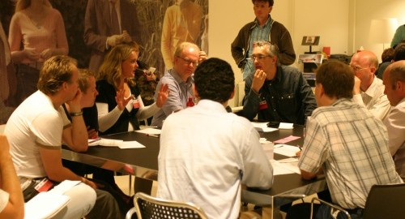
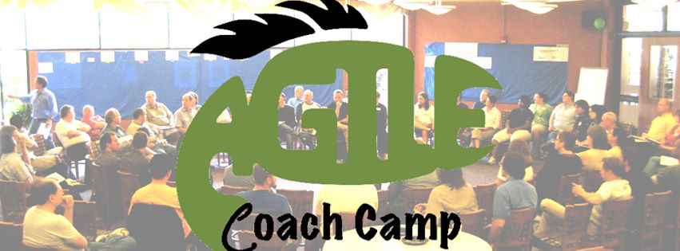
Learning about retrospectives
Agile Open Holland
WHAT?

Slide 59

?
Notes:
Questions?

Slide 60

Notes:
Questions?

